Slide 1
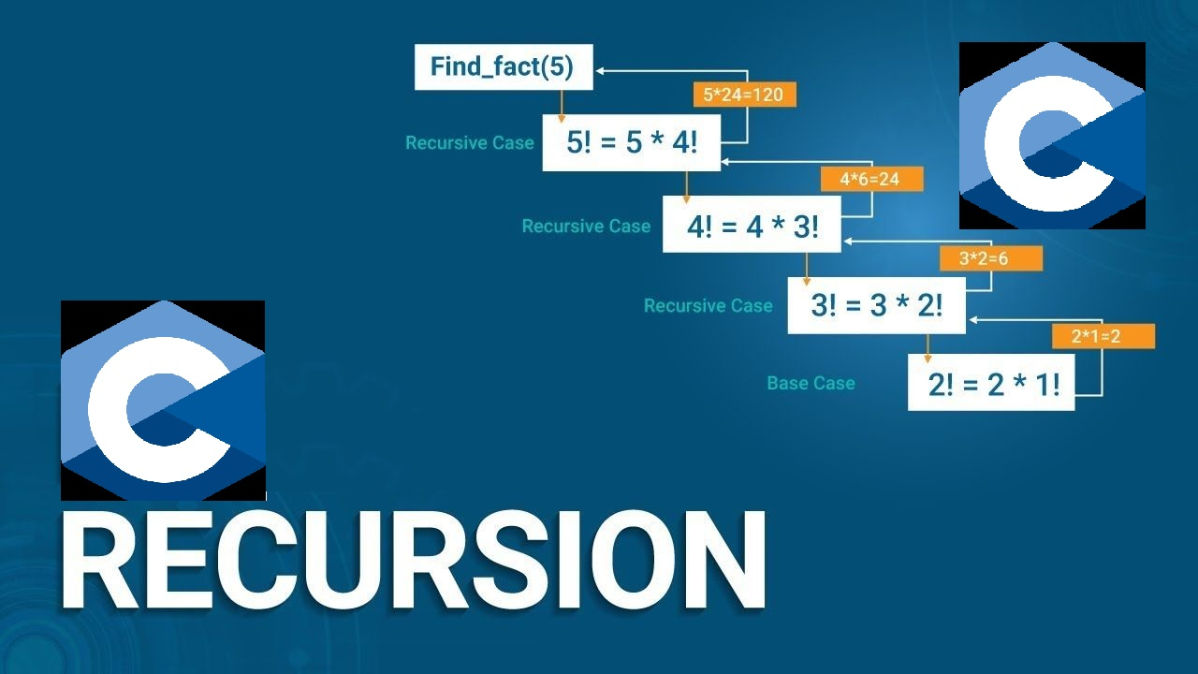

Slide 2
Recursion
Recursion refers to the processes of repetition of a particular task in order to achieve a specific purpose.
Recursion is the process in which a function calls itself till the task is completed.
A function which calls itself directly or indirectly again and again until some specified condition is satisfied is known as Recursive Function.

Slide 3
Recursion
Advantages
Recursive functions in C enhance the readability of the program.
Used to solve problems that are inherently recursive in nature such as tree traversal problems and the famous Tower of Hanoi problem.

Slide 4
Recursion
Disadvantages
It requires a lot of storage space hence the program is comparatively slower than iterative functions.
The time complexity of recursion is greater than iteration.

Slide 5
Recursion
Types
There are two types of recursion in C
Direct Recursion
Indirect Recursion

Slide 6
Direct Recursion
Direct recursion is said to occur when the recursive call to the function is made within its own definition.

Slide 7
Direct Recursion
Example
int fun1()
{
fun1();
}
void main()
{
fun1();
}

Slide 8
Indirect Recursion
Indirect recursion is said to occur when a particular function is called in recursive way medium of another function.

Slide 9
Indirect Recursion
Example
int fun1()
{
fun2();
}
int fun2()
{
fun1();
}
void main()
{
fun1();
}

Slide 10
Memory Allocation of Recursive Function
Each call to a function in c language results in memory allocation on the top of a stack. When a recursive function is called memory is allocated to it on the top of the memory and every time memory is allocated when each call of function because copy of same variable is created every time.

Slide 11
Memory Allocation of Recursive Function
Step - 7
main() called
Step - 5
Step - 3
STACK
fun N = 3
fun N = 4
main() Test = 4
STACK
fun N = 1
fun N = 2
fun N = 3
fun N = 4
main() Test = 4
STACK
fun N = 3
fun N = 4
main() Test = 4
Step - 1
STACK
main() Test = 4
Step - 8
Step - 4
STACK
fun N = 4
main() Test = 4
Step - 2
Step - 6
STACK
fun N = 2
fun N = 3
fun N = 4
main() Test = 4
STACK
fun N = 4
main() Test = 4
STACK
fun N = 2
fun N = 3
fun N = 4
main() Test = 4
Step - 9
STACK
main() Test = 4

Slide 12
Recursion
Program - 1
#include<stdio.h>
int main()
{
printf(“Hello\n");
main();
return 0;
}
OUTPUT
Hello
Infinite Times

Slide 13
Recursion
Program - 2
Program to find the factorial
#include <stdio.h>
int fact(int n)
{
if (n==0)
{
return 0;
}
else if ( n == 1)
{
return 1;
}
else
{
return n*fact(n-1);
}
}
OUTPUT
Enter the number : 4
Factorial 0f 4 = 24
int main()
{
int n,f;
printf("Enter the number : ");
scanf("%d",&n);
f = fact(n);
printf("Factorial of %d = %d",n,f);
return 0;
}

Slide 14
QUIZ

Slide 15
Quiz - 1
#include <stdio.h>
int main()
{
int x[5] = {1, 2, 3, 4, 5};
int* ptr;
ptr = &x[2];
printf("*ptr = %d \n", *ptr);
printf("*(ptr+1) = %d \n", *(ptr+1));
printf("*(ptr-1) = %d", *(ptr-1));
return 0;
}
OUTPUT
*ptr = 3
*(ptr+1) = 4
*(ptr-1)=2
Click here to see code

Slide 16
Coding Questions

Slide 17
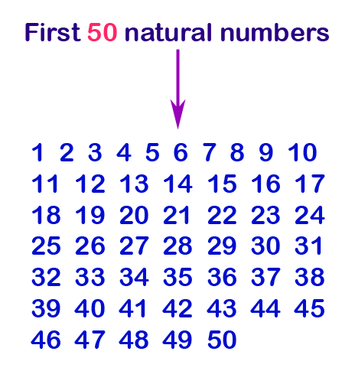
Question - 1
Write a program in C to print the first 10 natural numbers using recursion.
Click here to see code

Slide 18
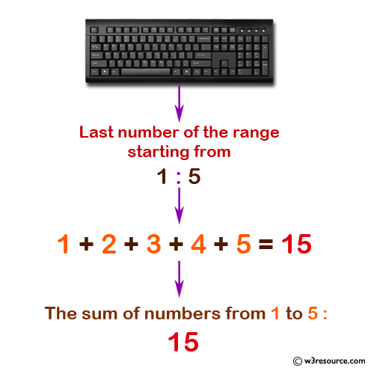
Question - 2
Write a program in C to calculate the sum of numbers from 1 to n using recursion.
Click here to see code

Slide 19
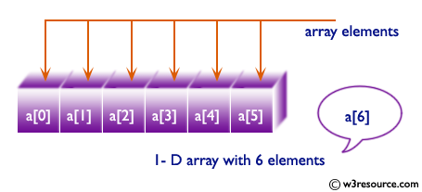
Question - 3
Write a program in C to display element of an array using recursion.
Click here to see code

Slide 20
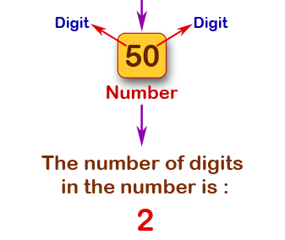
Question - 4
Write a program in C to count the digits of a given number using recursion.
Click here to see code

Slide 21
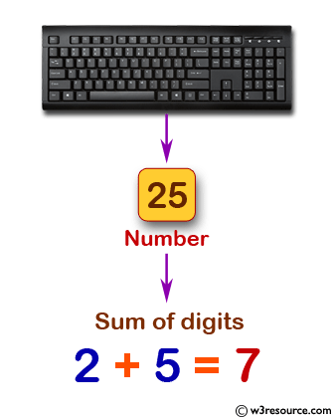
Question - 5
Write a program in C to find sum of digits of a given number using recursion.
Click here to see code

Slide 22
Question - 6
Write a program in C to print odd and even numbers in a given range using recursion.
Click here to see code

Slide 23
Question - 7
Write a program in C to print odd and even numbers in a given range using recursion.
Click here to see code

